Slide 1
GPU Prepare data: reduce or copy
O_{i}
NCCL initialization: ncclCommInitRank()
GPU
CPU
O_{i}
O_{l}
O_{sc}
O_{sc}
O_{sc}
O_{sc}
O_{sc}
O_{sc}
O_{sc}
O_{sc}
O_{f}
NIC
G*s
G*s
G*s
G*s
G*s
G*s
G*s
G*s
FIN
NIC
L
CPU
O_{i}
O_{l}
GPU
NCCL launch cuda kernel and proxy
Proxy overhead in sending data
NCCL finish overhead
O_{l}
O_{sc}
O_{f}
L: Upper bound on inter-processor latency

Slide 2
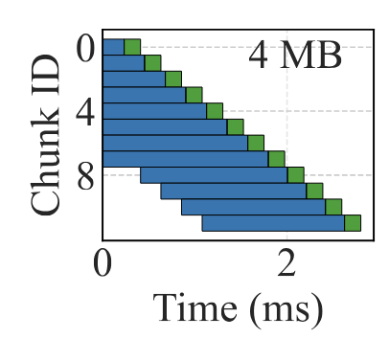
O_{sc} > G*s: data preparation time in GPU is longer than the time sending data to network
Hardware: A30 + 200 Gbps InfiniBand
G*s > O_{sc} : the time sending data to network is longer than data preparation time in GPU
Hardware: A100 + 25 Gbps RoCE

Slide 3

If Msg size is small: # Total steps = 2 * (#ranks - 1)
If Msg size is large: # Total steps = 2 * (#ranks - 1) * (Msg size / (# channels * Max chunk size))
Single-Chunk Collective: Ring
Step 0
Step 1
Step 1
P₀
P₁
P₂
P₀
P₁
P₂
Step 0
Reduce
Broadcast
# steps = #ranks -1
# steps = #ranks - 1
Total Steps = 2 * (#ranks – 1)

Slide 4

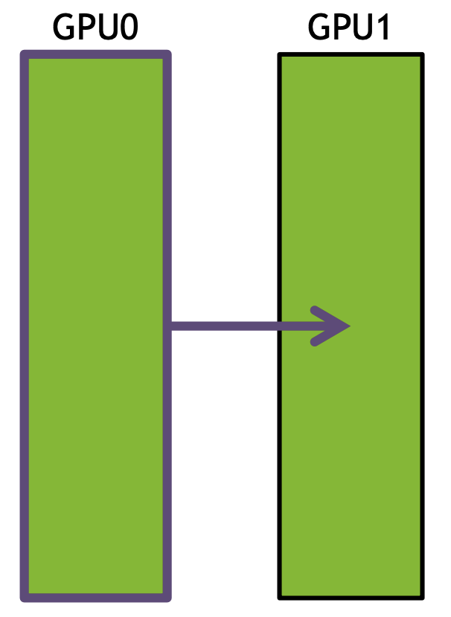
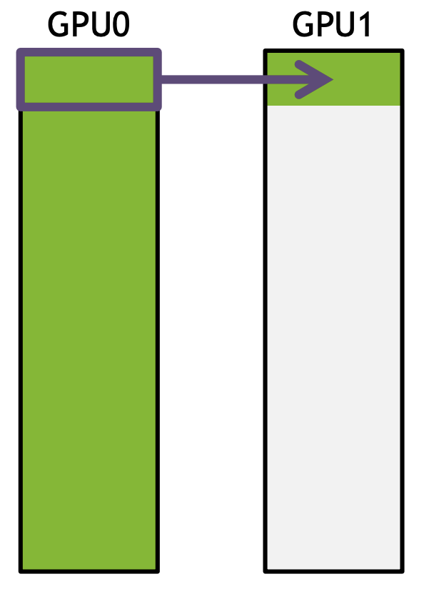
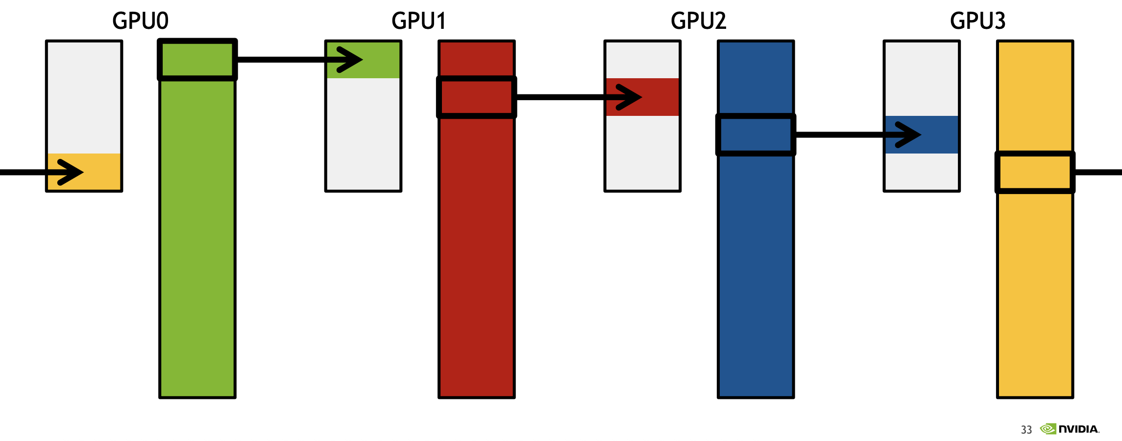
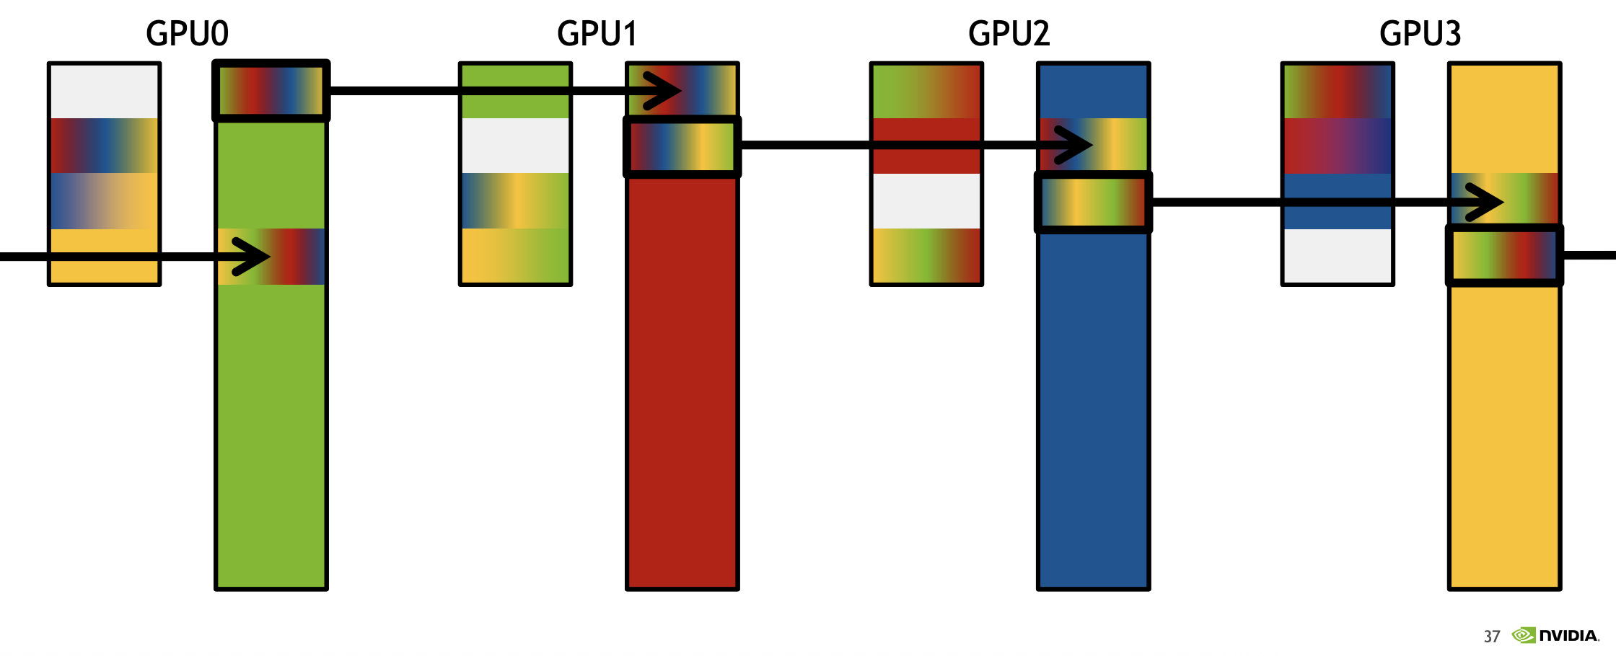
Multi-Chunk Collective: Ring
Split data into
multiple chunks
Send and receive happen concurrently on different chunks in each GPU.
# steps = ⌈message_size / (max_chunk_size × #channels × #ranks)⌉ × (#ranks - 1)
ReduceScatter
AllGather

Slide 5
Why Simple Multiplication Fails
T₀
Chunk 0
Proxy Send Process, Ring, Simple
FIFO Depth = 4
T₀ is the time of Chunk 0
T₀ = G × S + L’
If we get G through linear regression on T₀ = G × S + L’
So, the total time T_{total} = # Total steps * T₀ ? Wrong!
- Chunk 1 overlap with Chunk 0
Chunk 1
Chunk 2
Chunk 3
Chunk 4
Chunk 5
Chunk 6
Chunk 7

Slide 6
Why Simple Measurement Fails
T₀
Ring, Simple; FIFO Depth = 4
T₀ represents the transmission time for Chunk 0
T₀ = G × S_{chunk} + L’
Parameter extraction: We obtain G through linear regression on the relationship T₀ = G × S_{chunk} + L’
Naive calculation: T_{total} = G × S_{msg} + L’ = #chunks × (T₀ - L’) + L’
This is incorrect! ❌
Reason: Chunk 0 overlap with Chunk 1, 2, 3.
Chunk 0
Chunk 1
Chunk 2
Chunk 3

Slide 7
How to measure the time of each step?
T₀
T₁
Proxy Send Process, Ring, Simple
FIFO Depth = 4
1. Total time = T₀ + (number of chunks/ FIFO Depth -1) * T₁
2. number of chunks = 2 * (#ranks - 1) * (Msg size / (# channels * Max chunk size)) * 2
### the first 2 is from ring algorithm
### the second 2 is from NCCL proxy, proxy will split each chunk from CUDA kernel into 2 chunks when the chunk size >= 16 KB.
3. T₁ = G*S + L + o
4. T₀ is close to T₁
Chunk 0
Chunk 1
Chunk 2
Chunk 3
Chunk 4
Chunk 5
Chunk 6
Chunk 7
T₁
Chunk 8
Chunk 9
Chunk 10
Chunk 11

Slide 8

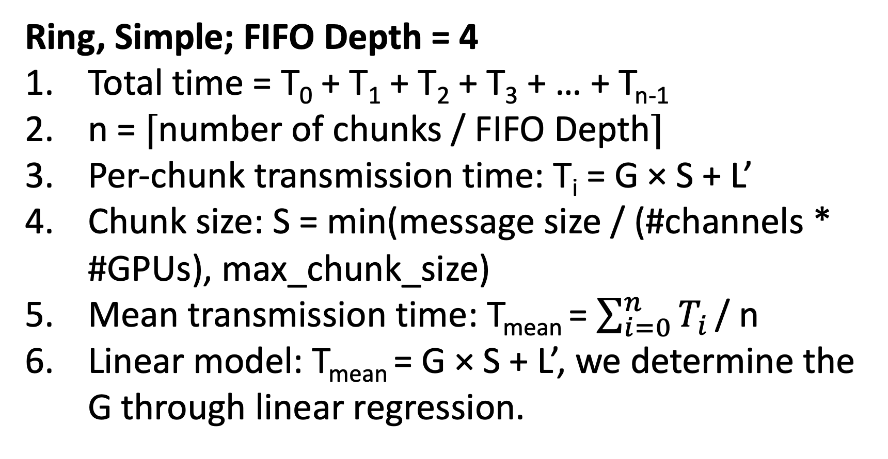
Ring Measurement Method
T₀
Ring, Simple; FIFO Depth = 4
Total time = T₀ + T₁ + T₂ + T₃ + … + T_{n-1}
n = ⌈number of chunks / FIFO Depth⌉
Per-chunk transmission time: T_{i} = G × S + L’
Chunk size: S = min(message size / (#channels * #GPUs), max_chunk_size)
Mean transmission time: T_{mean} = $\sum_{i=0}^{n}{T_{i}}$ / n
Linear model: T_{mean} = G × S + L’, we determine the G through linear regression.
Chunk 0
Chunk 1
Chunk 2
Chunk 3
T₁
Chunk 4
Chunk 5
Chunk 6
Chunk 7
T₂
Chunk 8
T₃
Chunk 12
T_{n-1}
Chunk 4 × (n-1)

Slide 9
When the chunk size in GPU Kernel<= 16KB, for example, now chunk size = 8KB
Chunk 0 (8 KB)
Chunk 1 (0 KB)
Chunk 2 (8 KB)
Chunk 3 (0 KB)
Proxy Send Process
FIFO Depth =4
Chunk 4 (8 KB)

Slide 10
When 16 KB <= chunk size in GPU Kernel < 32KB
Chunk 0 (16 KB)
The blue box is the bottleneck for the total communication, so the white box doesn’t matter
Chunk 1 (chunk size in GPU Kernel – 16KB)
Chunk 2 (16 KB)
Chunk 3 (chunk size in GPU Kernel – 16KB)
Proxy Send Process
FIFO Depth =4
Chunk 4 (16 KB)
Chunk 8 (16 KB)

Slide 11
Proxy Send Process, Tree, Simple
If FIFO Depth = 4
1. Total time = T₀ * (2 * log₂(# nodes))+ T₁
2. T₀ represents the preparation time for the first chunk, which involves intra-node reduction at each node.
Unlike the Ring algorithm where chunk size depends on the number of ranks (nranks), in the Tree algorithm, chunk size = msg size/#channels, and it has a fixed maximum value.
Therefore, T₀ follows two patterns:
For small messages (msg < ⍺): T₀ = L + o * message_size, Time increases linearly with message size.
For large messages (msg ≥ ⍺): T₀ = β (constant). Time remains constant due to the maximum chunk size limit
4. T₁ = G*S (S is message size)
T₀
T₁
Chunk 0
Chunk 0
Chunk 1
Chunk 2
Chunk 3
Chunk 4
Chunk 5
Chunk 6
Chunk 7
Chunk 8
Chunk 9
Chunk 10
Chunk 11

Slide 12
Tree Measurement Method
T
Tree, Simple, If FIFO Depth = 4
Total time: T = #chunks × G × S_{chunk} + L'
For large messages (message size > max_chunk_size): #chunks = message size / S_{chunk}
Substituting: T = message size × G + L'
Parameter extraction: This linear relationship enables determination of G through linear regression.
Chunk 0
Chunk 1
Chunk 2
Chunk 3
Chunk 4
Chunk n-1

Slide 13
First Chunk
Step 3
Step 0
Step 1
Step 1
Step 0
Step 2
Reduce
Broadcast
# steps = log₂(# nodes)
# steps = log₂(# nodes)
Total steps = 2 * log₂(# ranks)

Slide 14
Single-Chunk Collective: Tree
Step 3
Step 0
Step 1
Step 1
Step 0
Step 2
Reduce
Broadcast
# steps = log₂(# nodes)
# steps = log₂(# nodes)
Total steps = 2 * log₂(# nodes)

Slide 15
1. What’s the time of each step? 2. How about other chunks?
GPU Prepare data
O
Proxy overhead in sending data
L: Inter-processor physical latency
G: gap per byte
GPU
CPU
O
O
O
NIC
G*s
G*s
G*s
Step 0
NIC
CPU
L
GPU
T = 0
Chunk 0 arrived
T = O + L + G* S
Chunk 1 arrived
T = O + L + 2*G* S
Chunk 2 arrived
T = O + L + 3*G* S
The arrival time of first chunk is O + L + G*S
The time gap between consecutive chunk arrivals is G*S

Slide 16

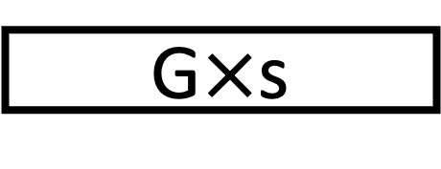
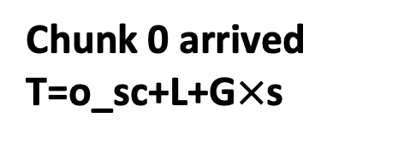

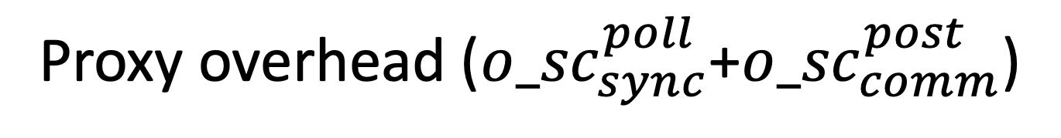
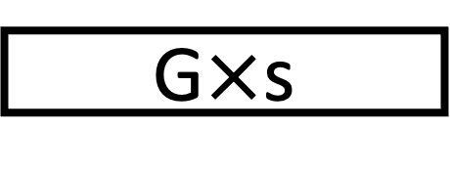
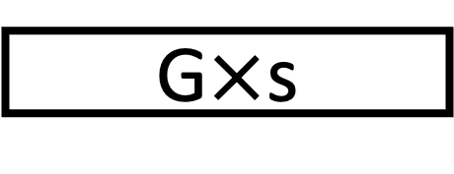

Multi-Chunk Collective: Tree
1. What’s the time of each step? 2. How about other chunks?
GPU Prepare data
o_sc
Proxy overhead (${o_sc}_{sync}^{poll}\text{+}{o_sc}_{comm}^{post}$)
L: Inter-processor physical latency
G: gap per byte
GPU
P₁
CPU
o_sc
o_sc
o_sc
P₂
NIC
G$×$s
G$×$s
G$×$s
Step 0
NIC
CPU
L
P₂
P₀
P₁
GPU
T = 0
Chunk 0 arrived
T=o_sc+L+G$×$s
Chunk 1 arrived
T=o_sc+L+2$×$G$×$s
Chunk 2 arrived
T=o_sc+L+3$×$G$×$s
The arrival time of first chunk is o_sc + L + G$×$S = L’ + G$×$S
The time gap between consecutive chunk arrivals is G$×$S

Slide 17
What’s the total time of AllReduce Tree
The time of first chunk: T₀ = (O + L + G*S) * log₂(# nodes) * 2
The time gap between consecutive chunk arrivals: T₁ = G * S * # chunks
Total time is T₀ + T₁

Slide 18
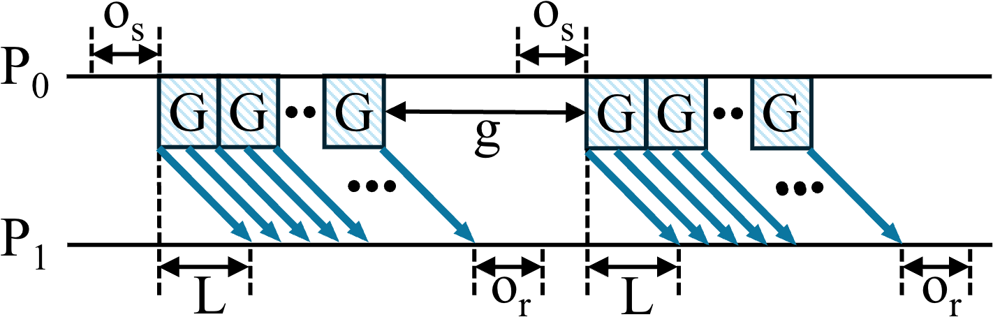
Communication Model (LogGP)
L: upper bound on message latency between processors;
o (o_{s}, o_{r}): overhead time during transmission or reception;
g: minimum gap between consecutive messages;
P: number of processors;
G: gap per byte for long messages.

Slide 19
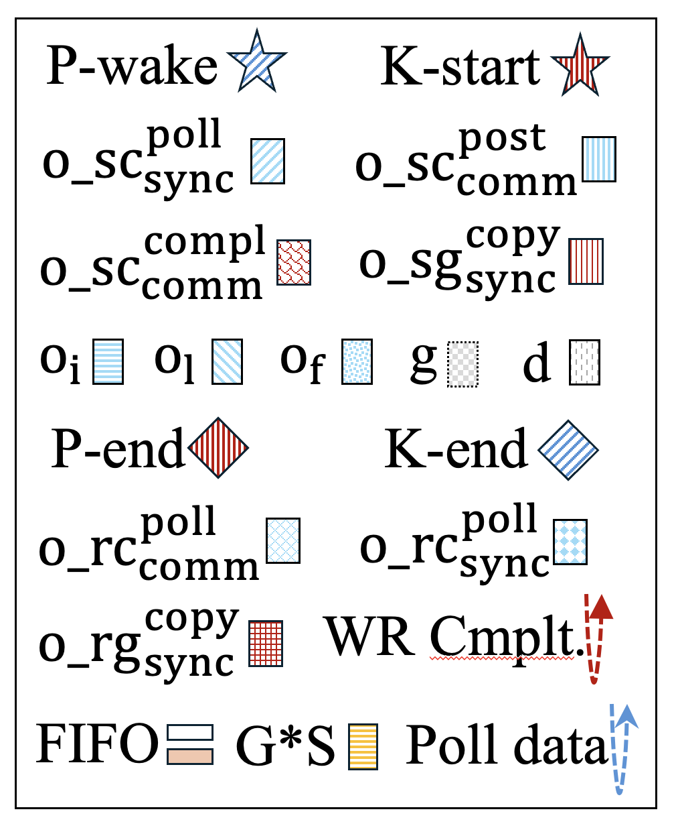







Usually, we call this Proxy-initiated GDR in CCLs
6. The sending GPU completes the data transfer
4. Recv: CPU proxy polls the NIC and forwards the data to the receiving GPU’s FIFO
What Does Comm. In NCCL Look Like?
7. The receiving GPU transfers the data from the FIFO to its destination buffer
CPU
GPU
NIC
NIC
GPU
CPU
1. GPU kernel is launched to compute and prepare data
2. CPU proxy begins polling the GPU to detect when the data in the FIFO;
Notify NIC
3. The NIC retrieves data from the FIFO via DMA; sends it to network.
5. The CPU proxy polls for the completion event, updates FIFO

Slide 20
LogGP Parameters in NCCL
L: time of proxy polled the data in the FIFO and post the isend (step 2) to proxy polled the complete event, updata the FIFO (step 5), data size should be very small, ie. 4 B.
G*s: NIC send data (size: s) to network (step 3).
CPU
P₀
GPU
NIC
NIC
P₁
GPU
CPU

Slide 21





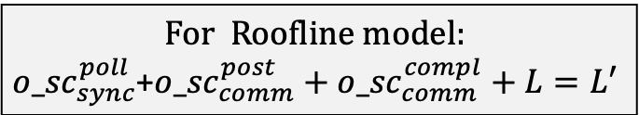

Ring
P₀
P₁
P₂
Let's start with P2P!
Single-Chunk Collective
P₀
$$G × S+L′$$
P₁
${o_sc}_{sync}^{poll}$+${o_sc}_{comm}^{post}$
$${o_sc}_{comm}^{compl}$$
GPU
CPU
$$G×s$$
L
P2P
Single-chunk Collective
Multi-chunk Collective
Parameter Measurements
NIC
NIC
CPU
GPU
For Roofline model:
$${o_sc}_{sync}^{poll}\text{+}{o_sc}_{comm}^{post}+{o_sc}_{comm}^{compl}+L=L′$$
Notes:
Nvidia:
https://developer.nvidia.com/blog/accelerating-hpc-applications-with-nsight-compute-roofline-analysis/
HPL (High Performance LINPACK): https://arxiv.org/pdf/2011.02617
Simulation: https://arxiv.org/html/2503.19050v1 https://1week.tistory.com/82

